Slide 1

A Study on Enhancing Hydrogen Release Property in Calcium Hydride through Ball Milling
PBLIV Thesis Presentation
Ibraheem Farzat
July 22nd, 2025
Supervised by: Prof. Takhiro Kondo
Notes:
The topic of my presentation for the college of Engineering Sciences is ‘A Study on Enhancing Hydrogen Release Property in Calcium Hydride through Ball Milling’

Slide 2

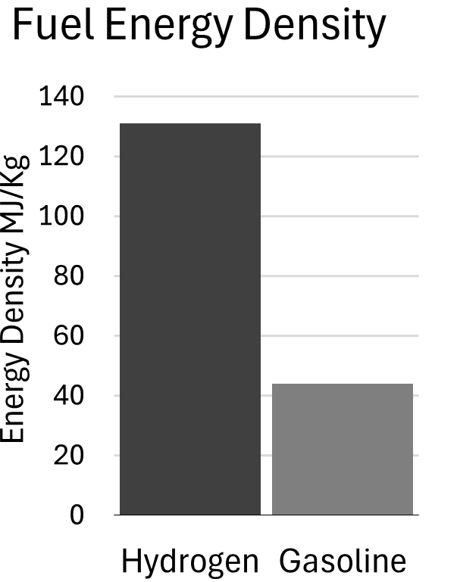
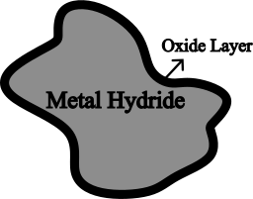
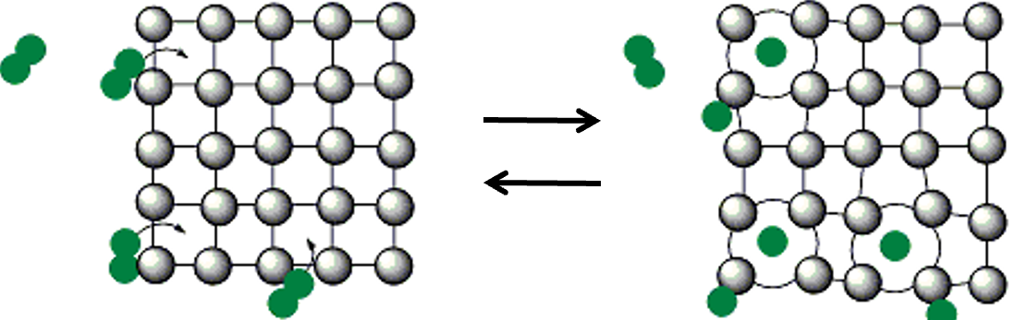
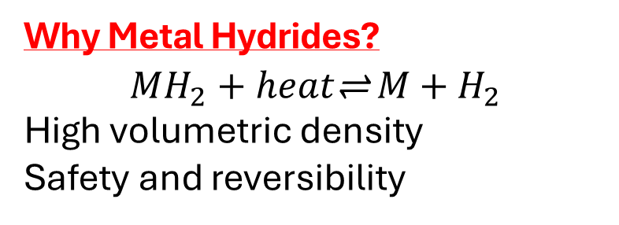
Background - Solid-State Energy Storage
Drawback: High temperature required to release the stored hydrogen oxide layer on the surface of the hydride particles
Greater adoption of EVs and Renewable Energy has increased demand hydrogen fuel
Why Metal Hydrides?
$$MH_{2}+heat\text{⇌} M+H_{2}$$
High volumetric density
Safety and reversibility
Notes:
Let's begin by looking at the context and background of our work.
With the rise of EVs and renewables, there's growing demand for petroleum alternatives. Hydrogen stands out for its high energy density—about three times that of gasoline by weight.
However, despite its potential, hydrogen storage remains a critical challenge. One of the emerging solutions is solid-state hydrogen storage, particularly through metal hydrides.
Metal hydrides are compounds formed when hydrogen reacts with metals or alloys. They store hydrogen by chemically bonding it within their crystal structure, allowing reversible absorption and desorption.
So, why metal Hydrides?
First, they have a high volumetric hydrogen density
Also, hydrogen is stored safely at relatively low pressures, typically between 2 to 10 megapascals.
Additionally, the hydrogen absorption and desorption processes are reversible, enabling multiple charge-discharge cycle.
------------------------------------------------------
However, One major drawback is the high temperature required to release the stored hydrogen. This is primarily due to the formation of a metal oxide layer on the surface of the hydride particles, which impedes hydrogen diffusion and slows down the desorption process.

Slide 3
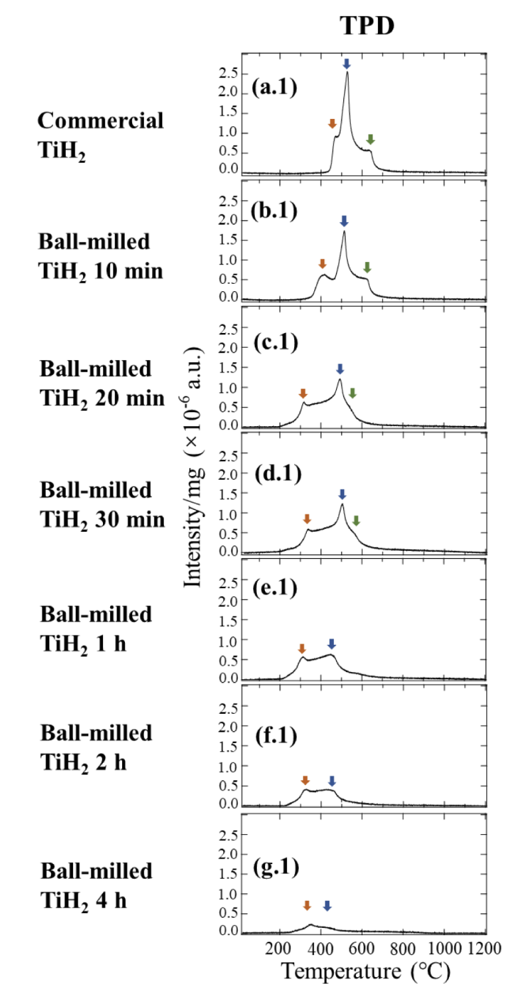
Background - Research Objective
Hydrogen release
Ball milling is used to lower H₂ desorption temperatures.
→ e.g. TiH₂ (4.0 wt%) : from 600 °C → 300 °C after milling¹
CaH₂ has higher hydrogen capacity (4.8 wt%).
But CaH₂ releases H2 at ~800 °C
Objective & Scope
Analyze how ball milling changes CaH₂ structure
Assess hydrogen release performance
Research Question : Can ball milling improve H₂ release properties from pure CaH₂?
[1] M. Yuan, et al., J. Phys. Chem. C 129 (2025) 6340–6351.
Notes:
To address this limitation, ball milling is used. Ball milling can induce structural refinement and improve hydrogen release behavior.
This approach was studied by Mei Yuan on TiH₂, where they observed a shift in hydrogen release temperature by nearly 300 degrees.
Motivated by this , we studied its effect on other metal hydrides, specifically calcium hydride (CaH₂). a promising hydrogen storage material due to its relatively high hydrogen content and low cost.
However, Cah2’s practical application is limited by several drawbacks. First CaH₂ is highly air-sensitive, has slow hydrogen release kinetics, and requires high desorption temperatures—typically around 800°C.
Therefore, in this work, we aim to answer the question: can ball milling improve H2 release properties of pure CaH2?

Slide 4


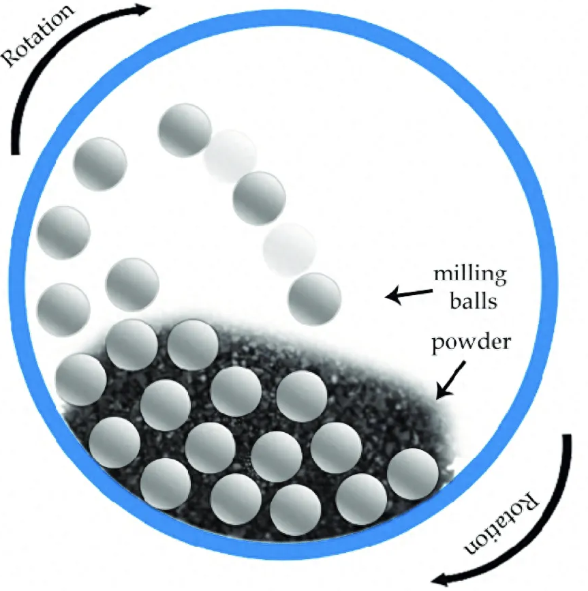
Methodology
Commercial CaH₂
Commercial CaH₂ (95%, argon glovebox)
Ball milling
150 mg milled: 10 min to 2 hr
Ball-to-powder ratio: 1:150
Analysis
Analyzed: Structure & H₂ Release
Notes:
We used high-purity commercial CaH₂, stored in an argon-filled glovebox to prevent air contamination. It was ball milled for durations ranging from 10 minutes to 2 hours.
Ball milling is a mechanical process where powder is repeatedly fractured by collisions with milling balls inside a rotating chamber. This process breaks down large crystals into finer particles, increasing surface area and exposing more reactive regions of the material. This can potentially enhance hydrogen release kinetics.
Post-milling, the samples are analyzed to understand how mechanical treatment affects the structure and hydrogen release behavior of CaH₂.

Slide 5
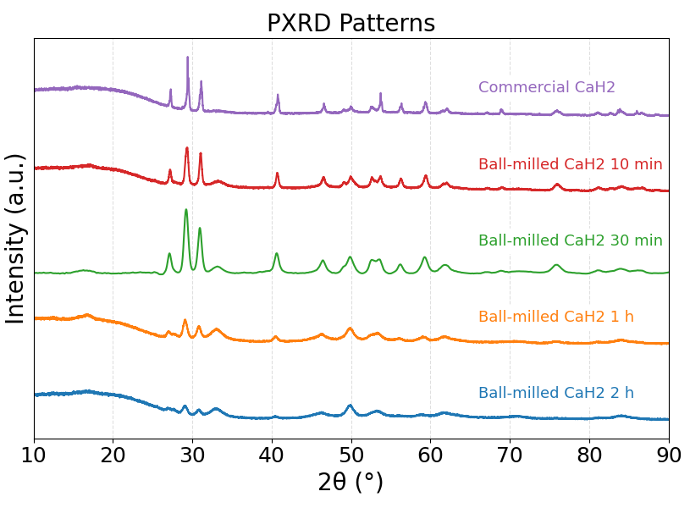
Results: Structural Changes
X-Ray Diffraction (XRD) used to identify phase composition and crystalline size
Ball-milling broadened the peaks
No formation or shifting of peaks indicating phase preservation of CaH₂
Notes:
To see how ball milling affects the internal structure of calcium hydride, we used X-ray diffraction, or XRD.
It’s a method that shines X-rays on a material and measures how they scatter—this tells us how big the crystal grains are and whether the structure has changed.
From the results we can see Peak broadening in all milled samples, with the extent of broadening increasing with milling time up to 2 hours. This broadening indicates a reduction in crystal size and an increase in lattice strain.
Importantly, the positions of the XRD peaks remained constant across all samples, confirming that no phase transformation or formation of new crystalline phases occurred during milling. The CaH₂ phase was preserved throughout the process.

Slide 6
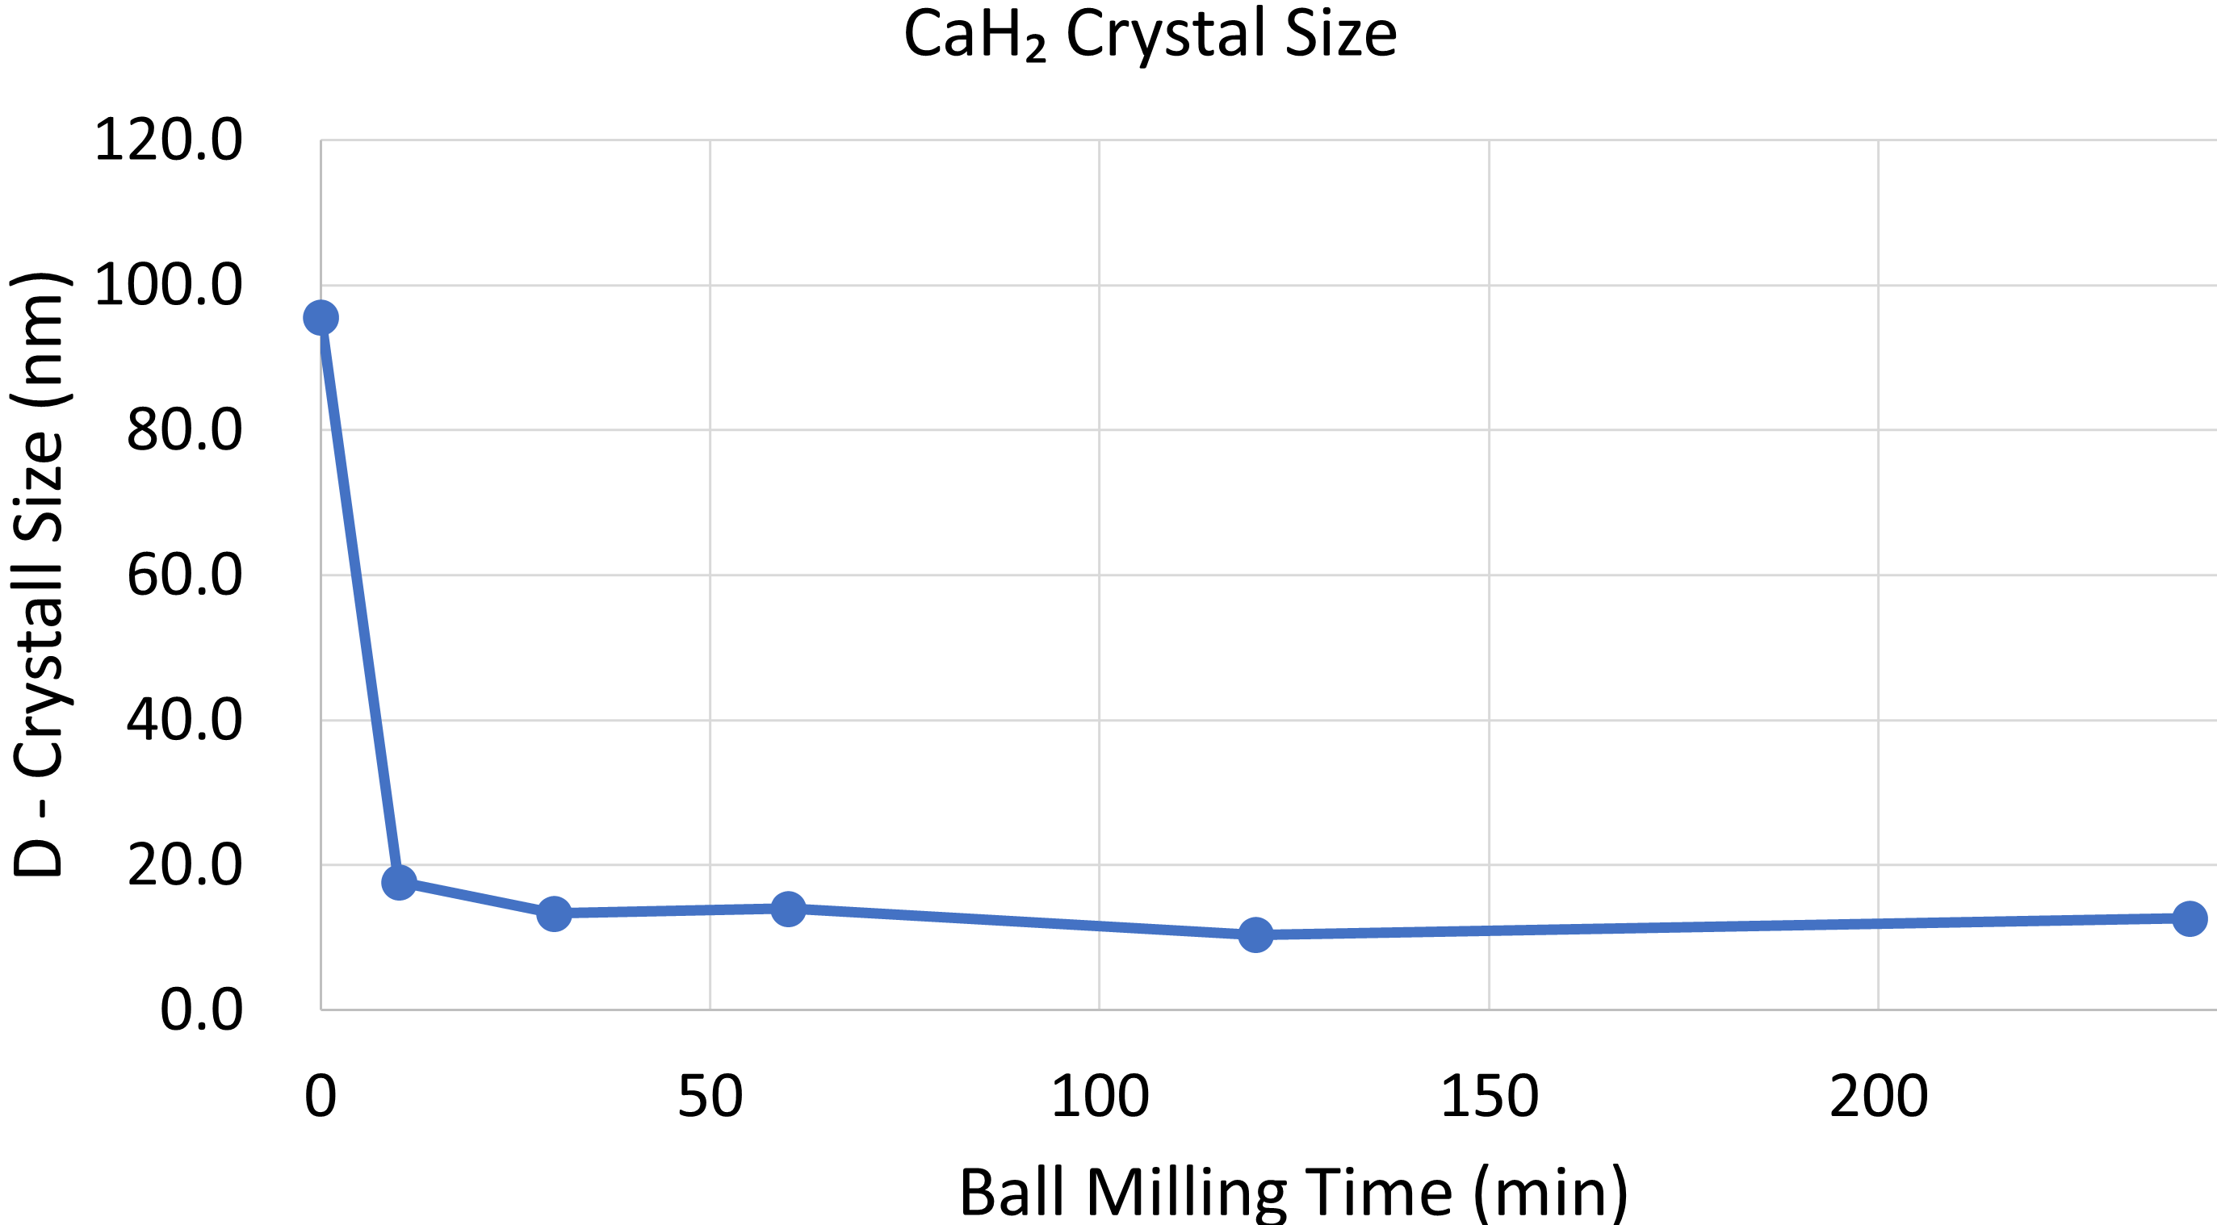
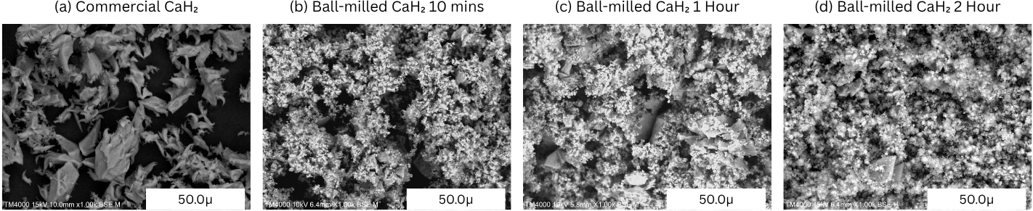

Results: Structural Changes
Crystaline size estimation using:
Scanning Electron Microscopy(SEM) - confirms reduced particle size
Constant
Peak Width
Crystal Size
$\text{D}\text{ = }\text{k}\text{λ}\text{ / }\text{β}\text{cos}θ$
Bragg Angle
X-ray Wavelength
Notes:
To estimate the crystal size of the ball milled CaH2, we used the Scherrer equation. Which uses XRD main-peak width to calculate the average size of the crystals
Using the peak near 29°, we found that the commercial CaH₂ had crystallites about 95 nm in size. After 10 minutes of milling, this dropped to 17 nm —only about 18% of the original. Milling for longer- up to 2 hours - resulted in smaller sizes, but the reduction leveled off, showing diminishing returns beyond 30 minutes.
To visually confirm this, we looked at images from scanning electron microscopy which clearly show that milling reduces the visible particle size, supporting the XRD-based size estimates. Like the XRD data, the SEM images also suggest that extended milling doesn’t significantly reduce the size further.

Slide 7
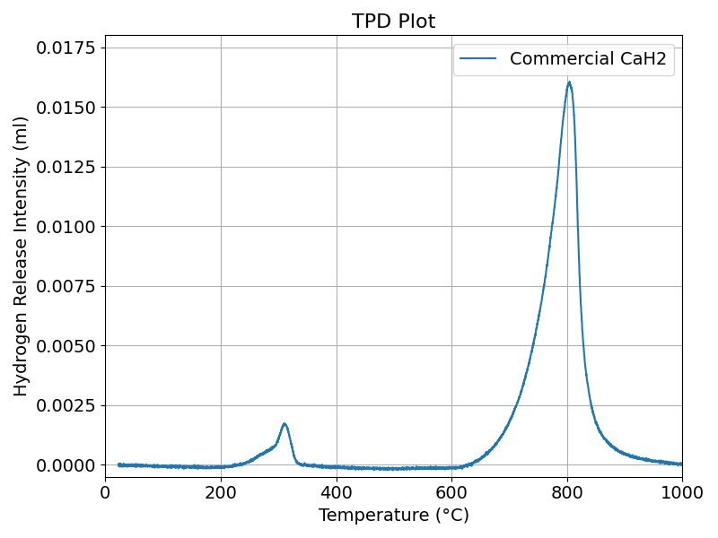
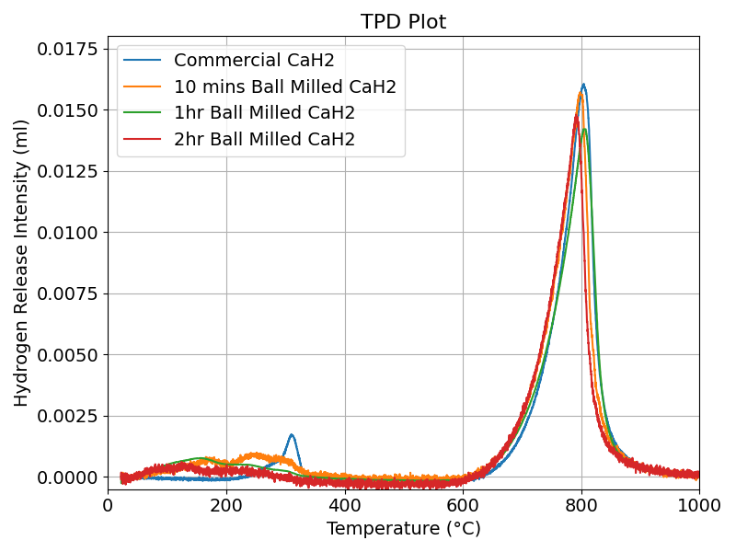
Results: Hydrogen Release
Two-stage hydrogen release
Effect of Ball Milling:
First peak shifted from ~300 °C → ~50 °C
  Peak broadened → enhanced surface reactivity
Second peak: minor shift (~10 °C), minimal change
2nd Peak
1st Peak
Notes:
Hydrogen release behavior was analyzed using temperature-programmed desorption, or TPD.
In the commercial CaH₂ sample, we observed two distinct hydrogen release peaks as the material was heated to 1000 °C. A relatively weak peak around 300°C, and a second more intense peak at a higher temperature. This suggests a two-stage release mechanism: surface release followed by bulk desorption.
-------------------------------------------------------------------------------------------------------------------------------------------------------------------------
Ball milling changed this behavior.
In the milled samples, the first hydrogen release peak shifted—from 300 °C to around 50 °C. This peak also became broader, which suggests improved reactivity at the surface due to increased surface area, higher defect density, and disruption of the surface oxide layer.
The second peak, however, changed very little. It shifted only about 10 °C and showed little variation across different milling durations.
This implies that deeper, bulk hydrogen release is less affected by mechanical treatment.

Slide 8
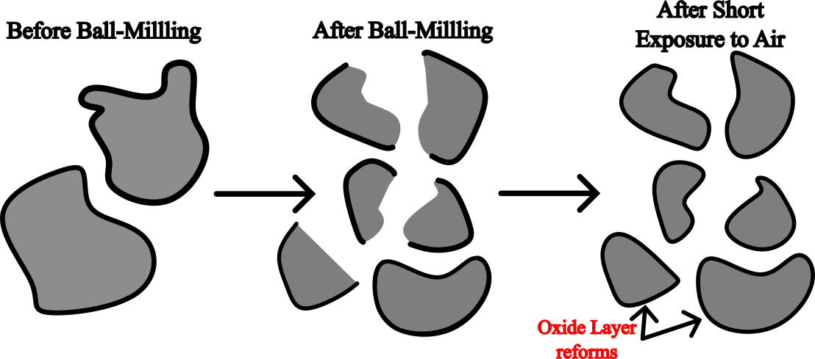
Discussion
A thin surface oxide layer may have re-formed during sample handling?
Notes:
One likely reason as to why the there is no shift in the second peak might be because a thin surface oxide layer re-formed during sample handling and moving between machines, limiting its impact deeper inside.

Slide 9
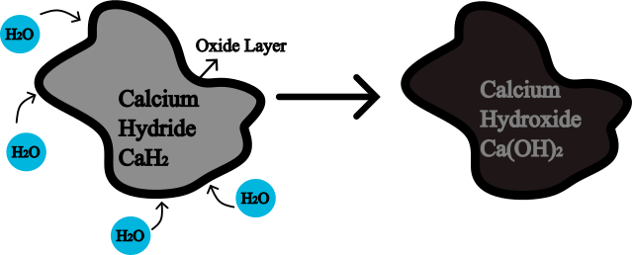
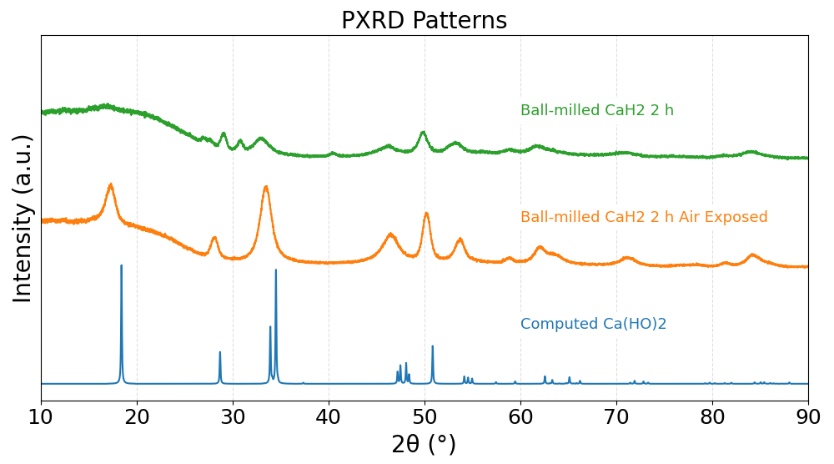
Discussion
Air-exposed sample forms Ca(OH)₂
Oxide/hydroxide barrier limits milling effects
Bulk H₂ release still restricted
Similar XRD profile
CaH2 readily forms Ca(OH)₂. Maintaining the surface integrity of CaH₂ is important.
Notes:
To check if our milled CaH₂ sample was affected by air during handling, we exposed a sample overnight.
XRD analysis revealed that instead of forming calcium oxide (CaO), the sample had mostly converted to calcium hydroxide, Ca(OH)₂. This indicates that CaH₂ reacts readily with moisture in the air, undergoing hydrolysis rather than simple oxidation.
This highlights a key limitation in our study—maintaining the surface integrity of CaH₂ after milling is important.
Even brief air exposure can significantly alter the surface chemistry, which may affect the hydrogen release, especially in the second desorption stage.

Slide 10
Conclusion
Background: Calcium hydride (CaH₂) is a high-capacity hydrogen storage material but suffers from poor kinetics and surface instability.
Aim : To enhance the hydrogen release properties of pure CaH₂ using ball milling and analyze the impact on structural and thermal behavior.
Results
First-stage hydrogen release significantly improved after ball milling - temperature reduced from ~300°C to ~50°C
Crystallite size reduced to ~10–17 nm, saturating beyond 30 min milling time
Air exposure caused conversion to Ca(OH)₂
Second-stage hydrogen release largely unchanged, indicating surface barrier effects
Notes:
In summary, ball milling shows potential in improving hydrogen release in CaH₂ by reducing crystal size and enhancing reactivity by lowering the onset temperature of the first-stage desorption and broadening the release profile.
However, Bulk desorption remained unchanged likely due to stable surface layers.
Future work should focus on , improved surface control, handling strategies, and the introduction of a reactant that breaks the oxide layer to further enhance hydrogen release.

Slide 11
Thank you for listening
Notes:
And that brings me to the end of my presentation. Thank you.

Slide 12
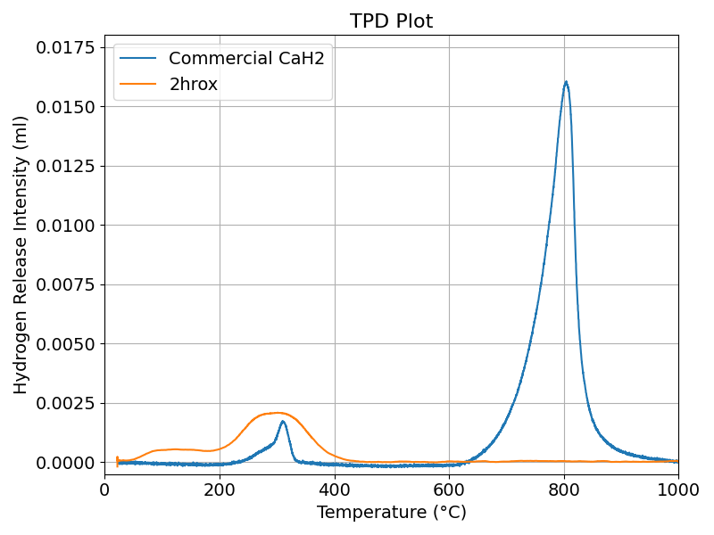

Slide 13
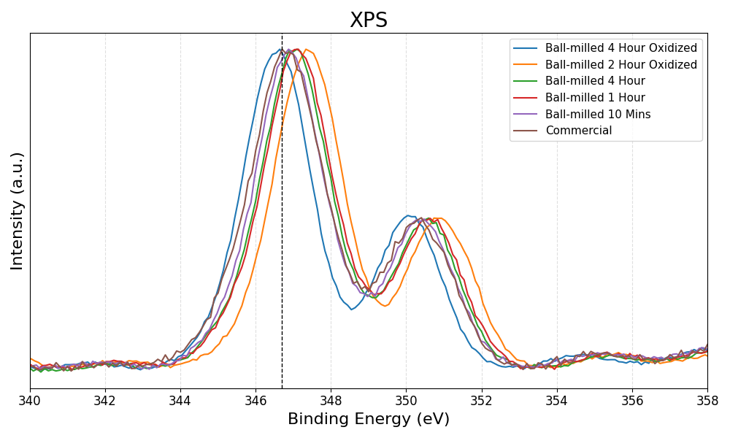
Surface Chemistry Analysis

